Slide 1

ML-Agent for Hyper/Hybrid Casual Games
By Mehdi Mehri

Slide 2
Topics to be covered
1- Ml-agent
2- Logic
3- Hc games & ml-agents
4- Benefits
5- Install
6- Hello word example!
7- IO game example
8- Puzzle example
9- Ragdoll example
10- Conclusion
11- References & contact us

Slide 3
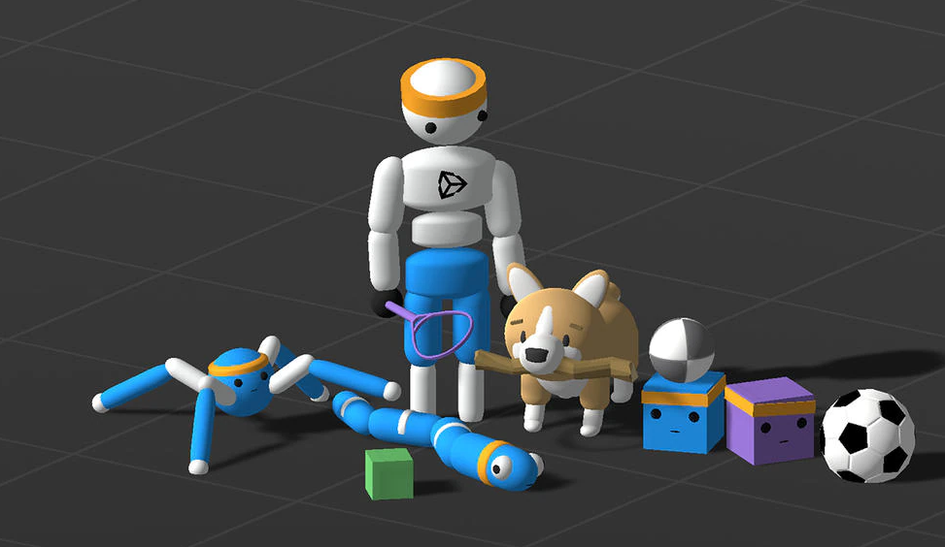
ML-agent
On September 17, 2017, the first version of Unity Machine Learning Agents Toolkit (ML-Agents) was released.
Current version : 2.3.0-exp.3 - 2022-11-21
https://unity.com/products/machine-learning-agents
https://github.com/Unity-Technologies/ml-agents

Slide 4
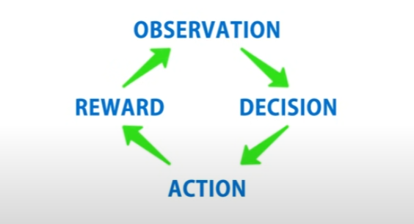
ML-Agent Logic

Slide 5
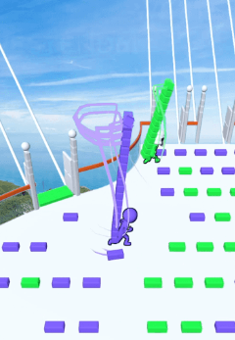
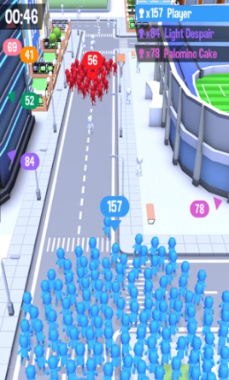
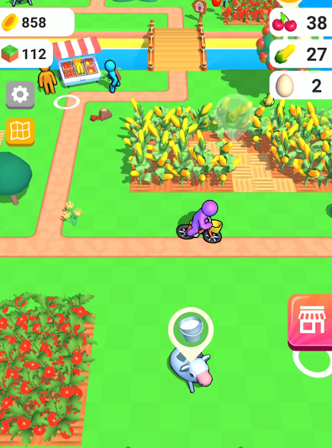
Hyper/hybrid casual games and ML-agent
It’s good for :
Any hc games that have competition like IO, Racing, and Staking games.
Can use for the enemy's behavior.
Can use for NPC’s AI ( farming, restaurants, hotel)
It’s not preferred to use on all hc games like Runner or Simulator games!
It’s not preferred to use in the first test phase.

Slide 6

Benefits of Ml-Agents
Modify the game’s difficulty based on user experience using the internal controller or remote config.
Increase player retention (better than old AI systems).
Increase satisfaction ( online game feeling ).
Low price (compared to online games ).
Easy to set up and train brains!

Slide 7

Python setup
Install Python (3.8.13 or higher)
Create environment & active environment
python -m venv [EnvName]
Install / upgrade pip
python -m pip install pip --upgrade pip
Install Torch
pip3 install torch~=1.7.1 -f https://download.pytorch.org/whl/torch_stable.html
Install mlagents-learning
python -m pip install mlagents==0.30.0

Slide 8

Editor Setup (IO game)
Install Unity (2021.3 or later)
Install the com.unity.ml-agents Unity package
Install the com.unity.ml-agents.extensions Unity package (Optional)
Write game logic for agent
Add ml-agent component
Run command mlagents-learn
Start train agent
Multiply agents

Slide 9
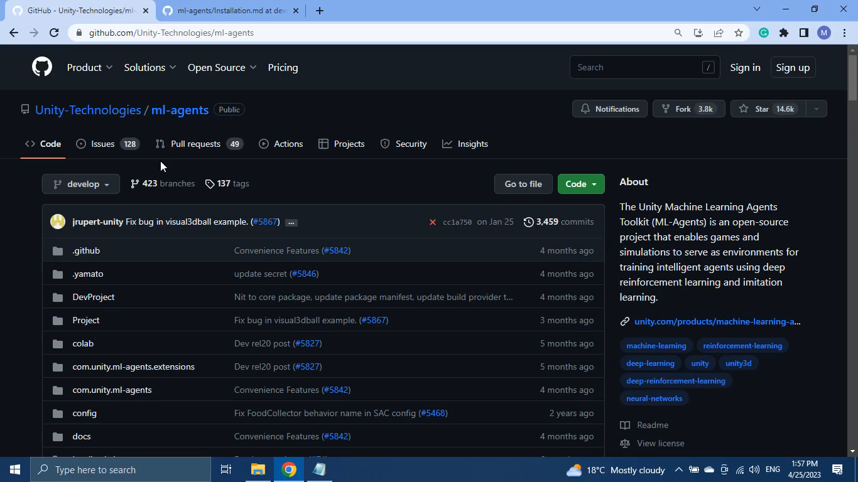
ML-Agent Setup (video)

Slide 10
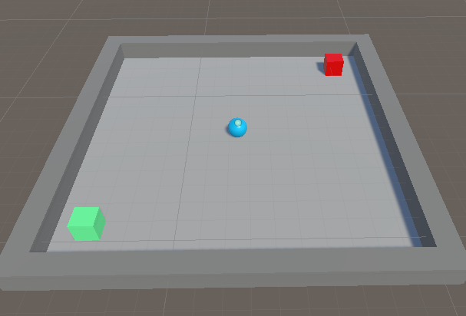
Simple ml-agent project
After install everythin, lets see how to train your first agent.
Start with setup your scene.
player
goals
trap
walls

Slide 11
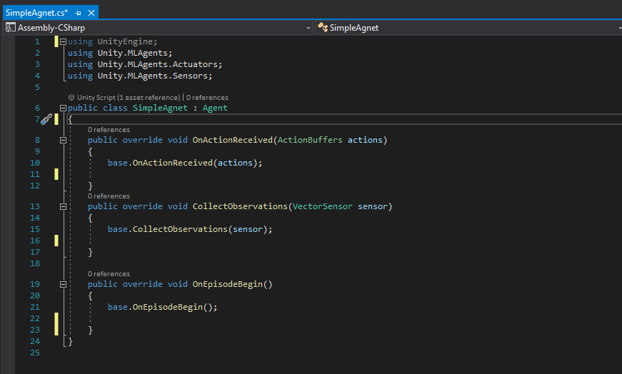
Crate a c# script

Slide 12
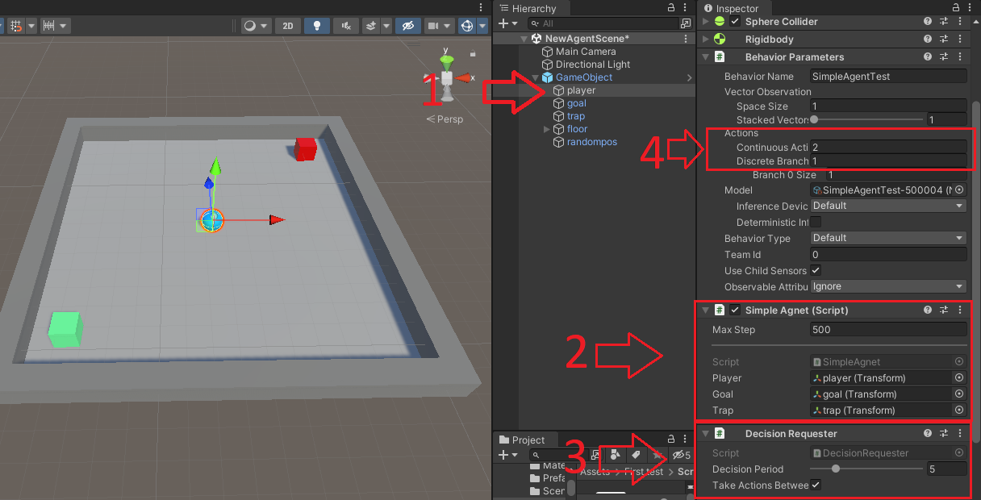

Slide 13
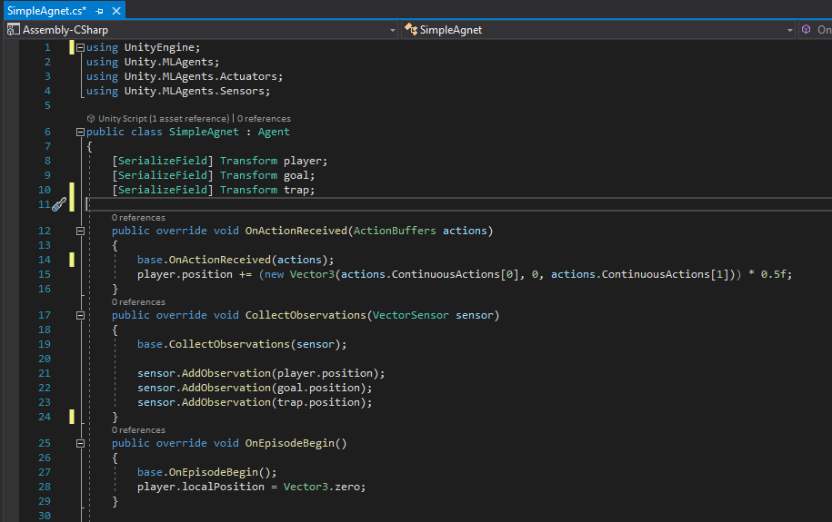

Slide 14
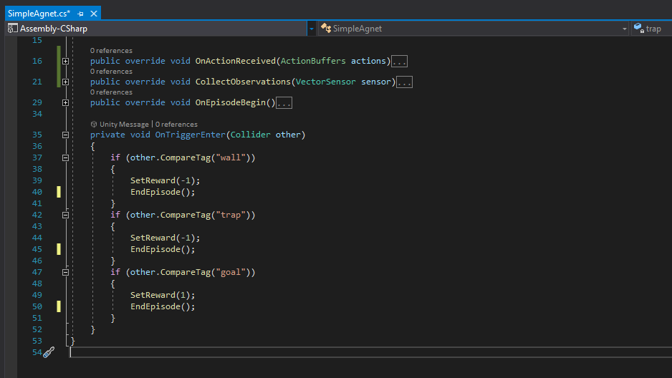

Slide 15
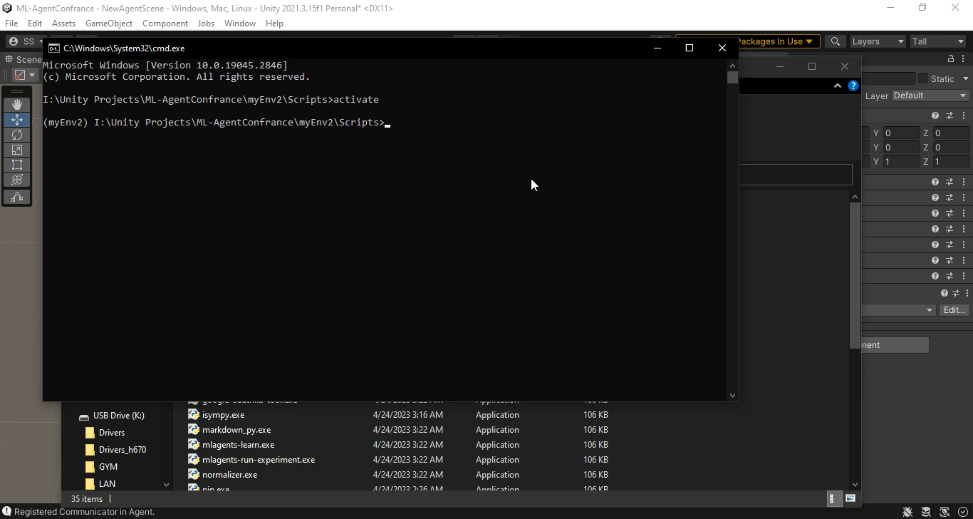
ML-Agents Start video

Slide 16
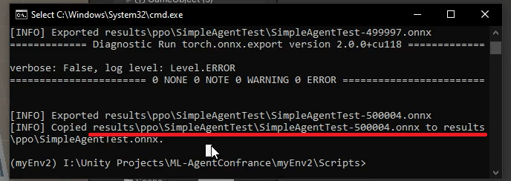
Using trained brain
Copy onnx file from result environment folder to your project.

Slide 17
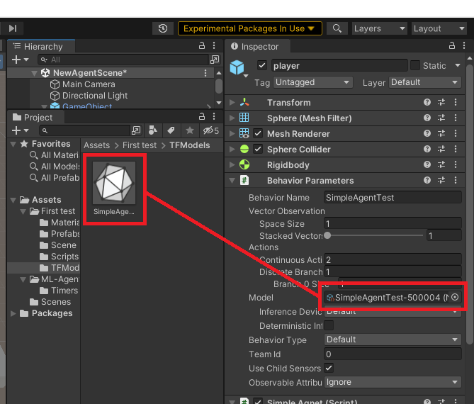
Set brain file to BehaviorParameters
Now you can press play button without starting mlagents-leran command and see how your brain act.

Slide 18
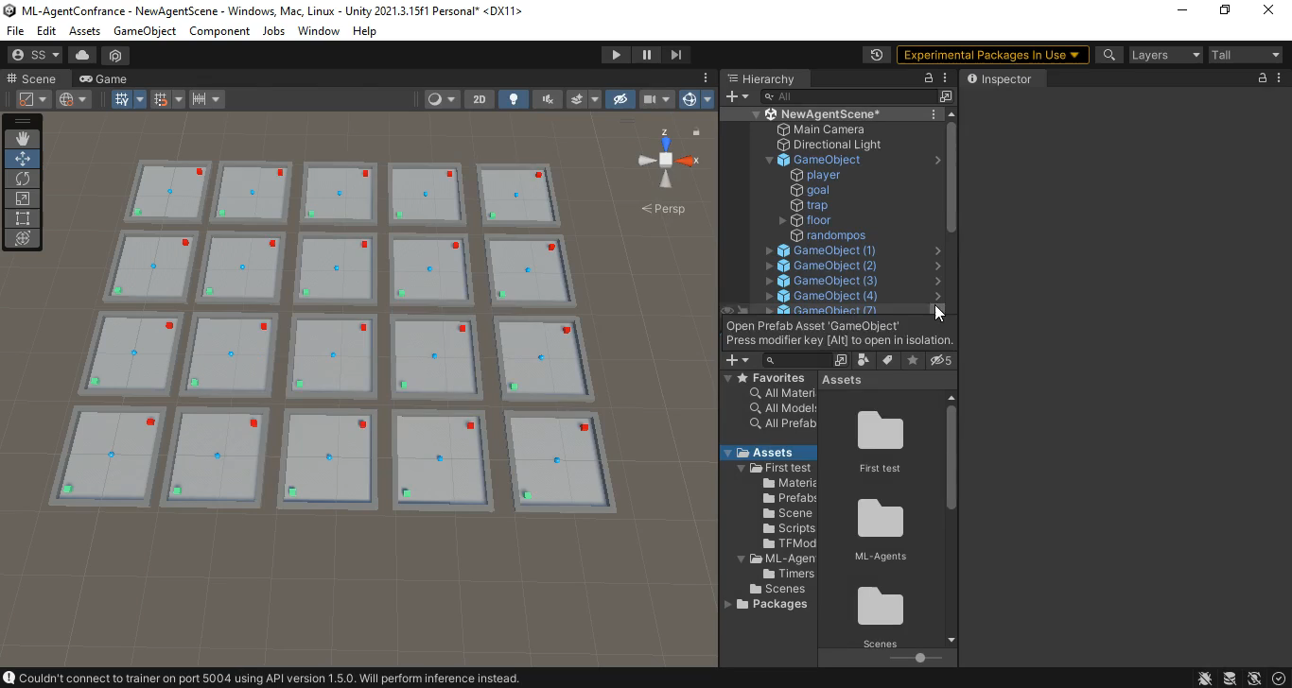
Using brain file video

Slide 19
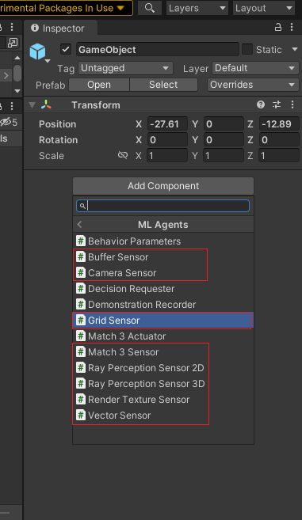
ML-agent for IO games
One of the key features of io games is competition, player need to feed he is playing with other player.
ML-agent package contain different sensor components. You can use right one for your project to make realistic behaviours.
In this example we implement ml-agent for simple IO games using grid sensor, in this games player must collect power up items, scale up, or collect bad items and scale down and defeat smaller enemies and survive the game.
Let see how ml-agent work in this sample :)

Slide 20
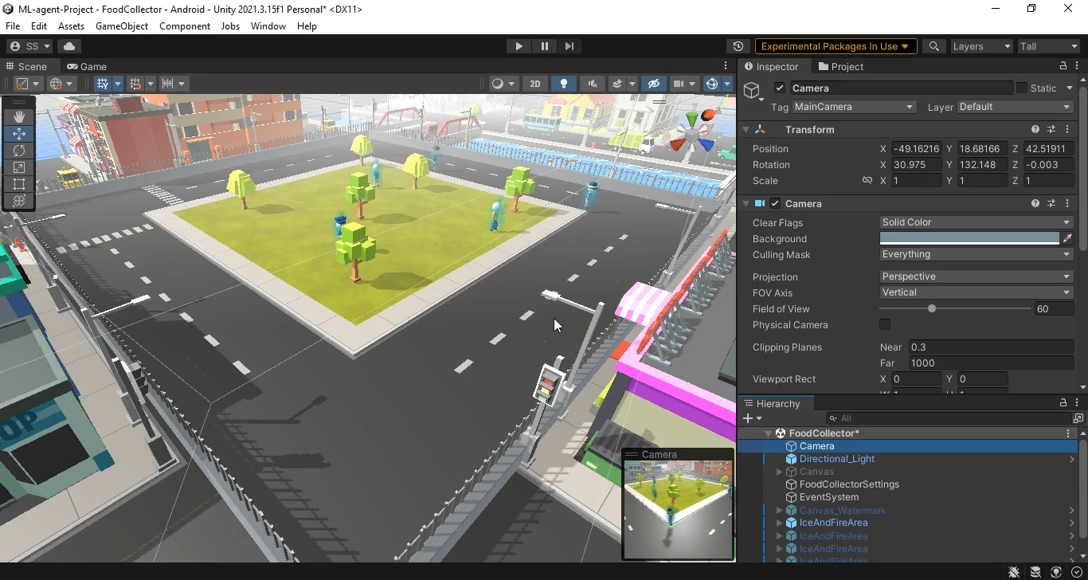

Slide 21
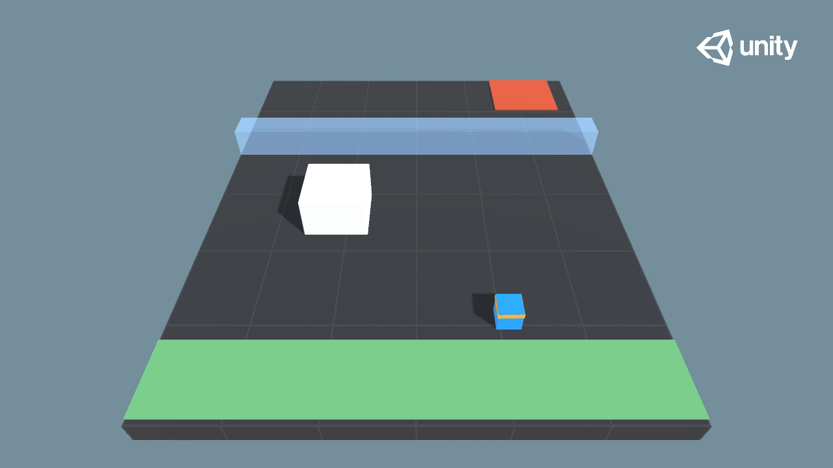
Unity puzzle example

Slide 22
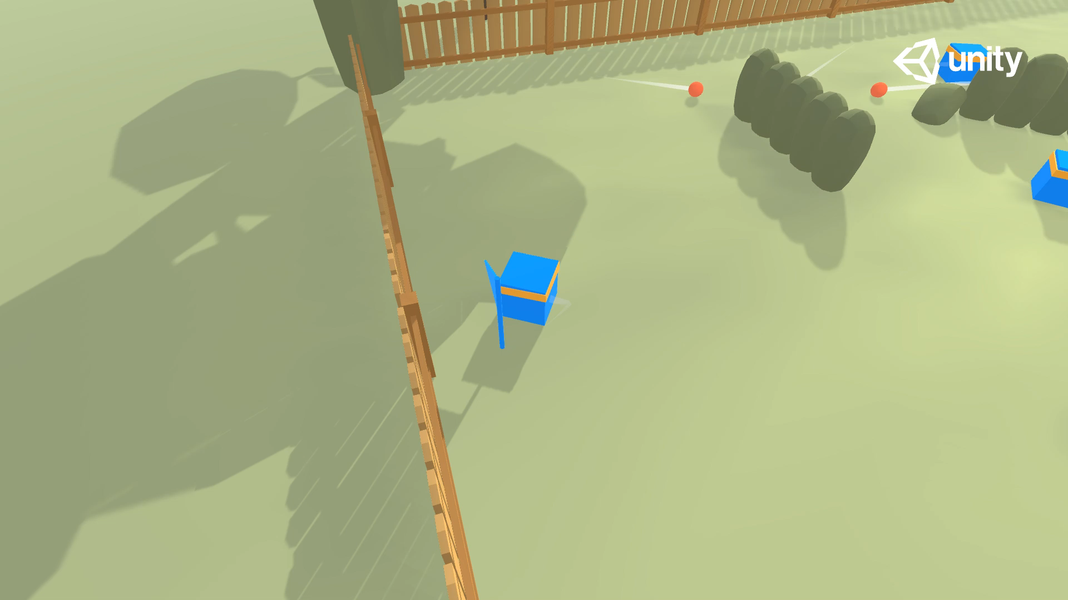
Unity Dodgeball example

Slide 23
Conclusion
You can use ml-agent for any IO games
Racing games ( cars, airplanes, ships …)
Sport games ( like tennis, football, basketball …)
P vs P games (staking, shooting, crafting …)
Smart enemies behavior in games ( Mazze, puzzle, hide & seek …)
Fake competition ( Chess, backgammon … )
Test your game functionality!

Slide 24
References
https://github.com/Unity-Technologies/ml-agents/
https://unity.com/products/machine-learning-agents
https://www.youtube.com/@CodeMonkeyUnity

Slide 25
Thank you!
How to reach us:
More information:
www.artingame.at
https://www.linkedin.com/company/artingameat/
https://www.linkedin.com/in/mehdi-m-820172177/

